Slide 1
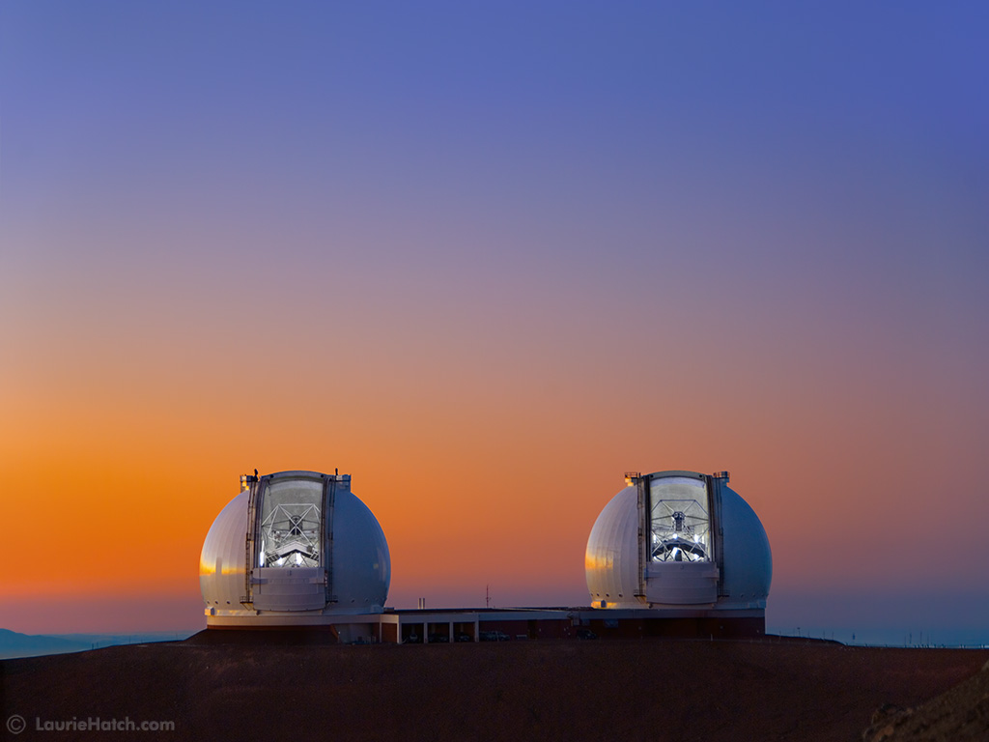
Time Domain Astronomy at the W.M. Keck Observatory
Randy Campbell, WMKO
Ned Molter, UCB

Slide 2
2005 Keck Strategic Planning meeting, the Keck community articulated the need to better facilitate Time Domain Astronomy.
Working group formed, TDAWG, generated report in 2006
TDA Science in 2006:
Accelerating Universe (Riess et al. 1998; Perlmutter et al. 1999)
Black hole mass from orbits of stars around Sgr A* (Ghez et al. 2005)
Discovery of more than 100 exoplanets (Marcy et al. 2005)
Discovery of Eris’ moon Dysomnia (Brown et al. 2006)
Nature of GRB’s (Metzger 1997, Bloom 2006)
Monitoring and spectra of volcanic eruptions on IO (Marchis et al. 2002)
2006 Working Group Recommendations
Create a Data Access Project
Facilitate communication between observers and TD scientists
Create of one-stop shop (real-time) website
All instruments that are possibly available for TDA science should be readied to the extent possible given resources
History of TDA at WMKO
Notes:
TDA included in last two strategic plans, 2009, 2016
Talk about what is “classic”, one program
Haven’t really done the last 3 but
In the past each institution had their own policies
But as of the last year, the SSC adopt a common policy for the observatory

Slide 3
WMKO Current TDA Policy
New scheduling rules to accommodate cross-institutional cadence and targets of opportunity
Applies to all major partners
Keck scheduler now has more flexibility to insert Cadence
Designed to minimize impact on short programs (1/2 night or smaller) – Limitations:
No instrument changes
Number of interrupts (4ea), snapshots (4ea), limited per TAC partner
60 min clock time for ToO
Individual Observers are not compensated,
Institutional time is reconciled each semester
60 min for snapshot cadence programs
Volunteer twilight program
¼ and ½ nights only limited by schedule
¼ nights should be allocated for scientific reasons
Science programs determined by TACs
No discretionary time
Observatory does NOT make real-time decisions on transient observations
Notes:
1 policy implemented in 2017A
Very useful to us trying to administer, particularly for scheduling cadence, but also for handling interrupts
Example split up whole night allocations to fit in series of partial night cadence programs
Trial period,
Observatory trying to asses the value, what are the trade offs,
As we shift towards TDA, what are we giving up.
Community still places value on classic model, wants to minimize impact

Slide 4
Planned Night Distribution Past New

Slide 5
TDA Development
Proposal cover sheets now include TDA specifics (ToO Cadence)
Cover sheets saved into data base
TACs have web interface to data base
Designate allocations
Distribute evenly
Policies and procedures web information
http://www2.keck.hawaii.edu/inst/common/too_policies.html
Observing Support
Reaching out to TD PI’s to better prepare
Need to to better in preparing Classical PI’s for interrupts
Scripted observations for cadence
Adding staff, Support Astronomer(s)
OA (TO) training
Reporting and time accounting system
Reconcile each semester
Notes:
Keep close track of partner observing time balance
Yet to do, improve schedule database and scheduling application

Slide 6
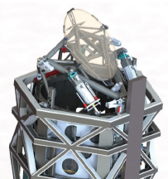
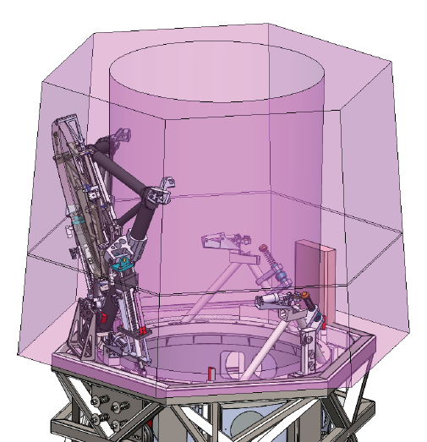
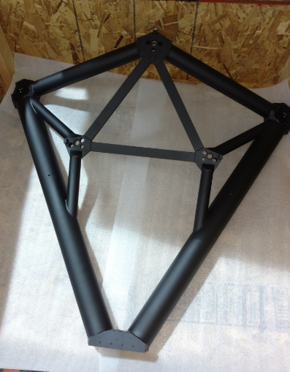
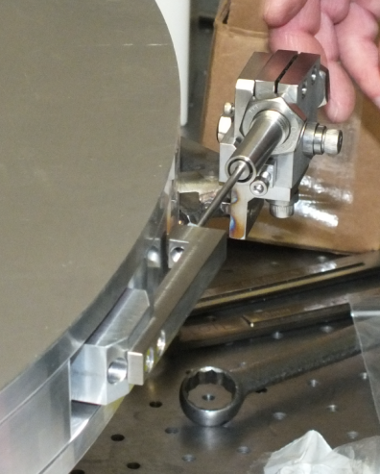
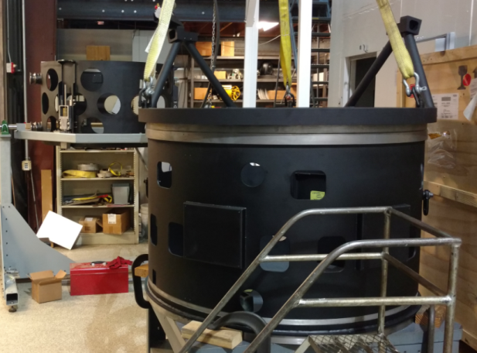
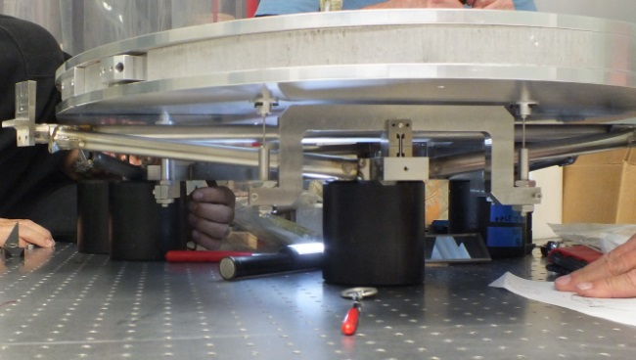
K1 Deployable Tertiary and Improved Telescope Control (TCS)
Will Remove restrictions on instrument changes
Rapid switch between Nasmyth and Cassegrain (~120 sec)
Module will remain inside the Tertiary Tower
Nasmyth instruments always available
OSIRIS, HIRES
Cass Instruments available:
Bright time MOSFIRE
Dark time LRIS
Outer and Inner Drums
Swingarm
Mirror Support Flexure
Whiffle Tree and Dummy Mirror
Notes:
In the future we will allow instrument switch, in fact we’re commissioning specifically for TDA
We may favor one Cass instrument if more ToO time is awarded

Slide 7
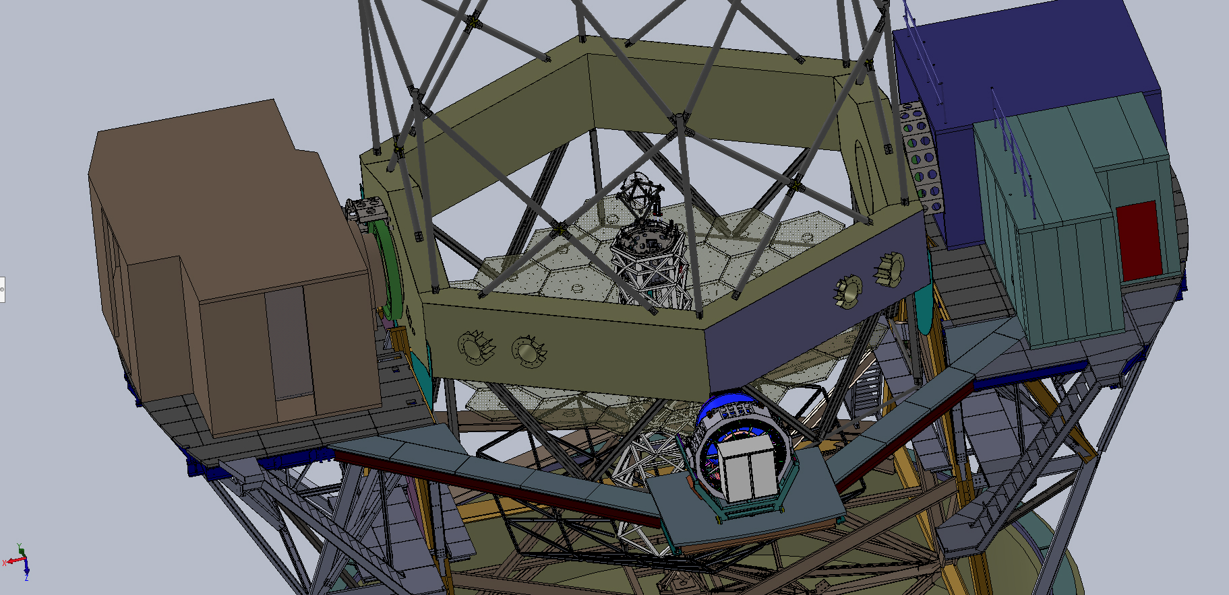
Keck I
HIRES
LASER
OSIRIS & AO
MOSFIRE

Slide 8
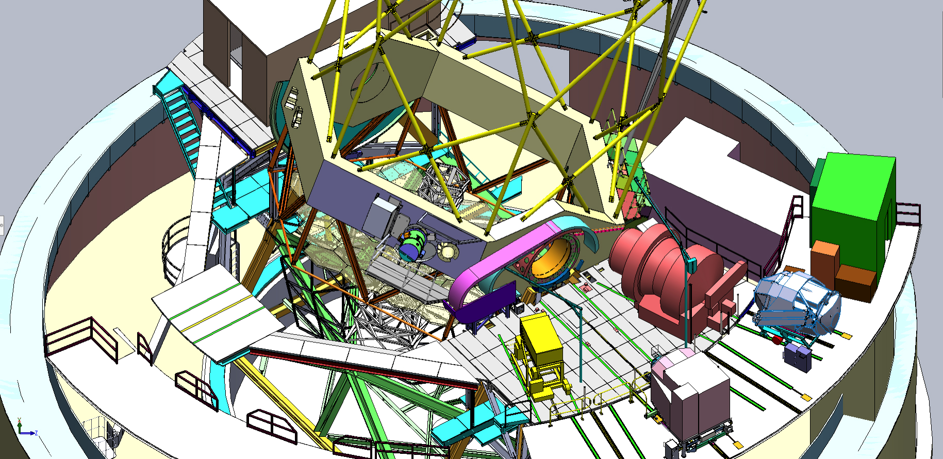
Keck II
NIRC2 & AO
LASER
DEIMOS
NIRES
ESI
NIRSPEC
KCWI

Slide 9
Twilight program
Notes:
Data and reduction quesitons, Luca Rizzi, KOA project scientist

